Slide 1
IBM University Engagement Project Submission
“Exploring the Power of Agentic AI with IBM Granite and IBM Bob”

Slide 2

Project Tile – Interview Trainer Agent
Domain of Project – Education
Student Name | Recent Passport Photo | Email ID | Mobile number [WhatsApp]
DINESH KUMAR G |  | dineshkumargdk27@gmail.com | +91 8072035825

Slide 3
Problem Statement
Interview Trainer Agent
The Challenge
Job candidates often lack targeted interview preparation matching specific resumes to exact job descriptions.
Generic platforms present static questions without evaluating technical nuances, clarity, or depth.
The Objective
Build an autonomous, RAG-powered Interview Trainer Agent that delivers hyper-personalized interview preparation and real-time evaluation for students and job seekers. The solution should:
Resume & JD RAG Retrieval: Process and index resumes and job postings into ChromaDB.
Targeted Question Generation: Generate role-specific questions across technical, behavioral, and project domains.
Real-Time Evaluation: Grade answers on technical correctness, relevance, completeness, clarity, and structure.
Adaptive Feedback: Identify candidate weaknesses and trigger follow-up questions dynamically.

Slide 4
Proposed Solution
Proposed Solution: AI-Powered Interview Trainer Agent
The proposed solution is a multi-agent AI-powered Interview Trainer Agent built using IBM Bob, IBM watsonx.ai, and Granite Models to provide personalized, real-time interview preparation and evaluation. The system addresses challenges in generic question banks, lack of personalized feedback, and static interview prep through an intelligent, modular architecture.
At its core, the solution uses a Retrieval-Augmented Generation (RAG) pipeline to fetch accurate context from uploaded candidate resumes and target job descriptions. This data is embedded and stored in a vector database (ChromaDB), enabling the system to retrieve role-specific skills, project experiences, and evaluation rubrics using Granite models to eliminate hallucinations.
The system consists of four key agents:
Resume & JD RAG Agent retrieves and summarizes candidate skills, project details, and job requirements using RAG.
Question Generation Agent generates role-tailored technical, behavioral, and project-based questions based on the candidate's target role, domain, and difficulty level.

Slide 5
Proposed Solution
Answer Evaluation Agent analyzes candidate answers across technical accuracy, relevance, completeness, clarity, and structure, offering instant scoring and error analysis.
Adaptive Feedback & Reporting Agent dynamically detects weak areas, generates targeted follow-up questions to probe deeper, and delivers grounded model answers with an overall performance scorecard.
The solution includes a user-friendly dashboard (built with Streamlit) that features an active interview room, an expandable "View Retrieved Context" panel for RAG transparency, and historical session tracking backed by SQLite.
The solution includes a user-friendly dashboard (built with Streamlit or React) that visualizes daily and weekly nutrient intake, highlights deficiencies, and tracks progress toward health goals.
IBM Bob is used to orchestrate agent workflows and scaffold code, while watsonx.ai ensures scalable model deployment, embeddings, and AI governance. Granite models power reasoning, question synthesis, and answer critique.
Overall, this solution delivers an end-to-end intelligent interview coach that builds candidate confidence, sharpens technical communication, and increases hiring success rates through grounded insights, dynamic follow-ups, and actionable feedback.

Slide 6
Technology Used
IBM Bob Platform: Used for designing, scaffolding, and orchestrating multi-agent workflows visually.
IBM Granite Model (e.g., ibm/granite-3-8b-instruct / ibm/granite-4-h-small): For natural language understanding, reasoning, role-specific question generation, and candidate answer evaluation.
IBM Cloud: Provides the infrastructure to build, deploy, and scale the Interview Trainer Agent efficiently, enabling a reliable and secure cloud environment.
RAG (Retrieval-Augmented Generation): Used to fetch real candidate and job context from uploaded resumes and job descriptions first, then generate grounded, hallucination-free interview questions and evaluations.
IBM watsonx.ai: For foundation model deployment, text generation parameters, and AI governance.
Vector Database (ChromaDB / FAISS): For storing document chunk embeddings and enabling semantic search across resumes and job descriptions.
Streamlit & Python: For building the interactive front-end interview interface, real-time scorecards, and session state management.
SQLite Database: For local persistent storage of interview session history, past questions, answers, and evaluations.

Slide 7
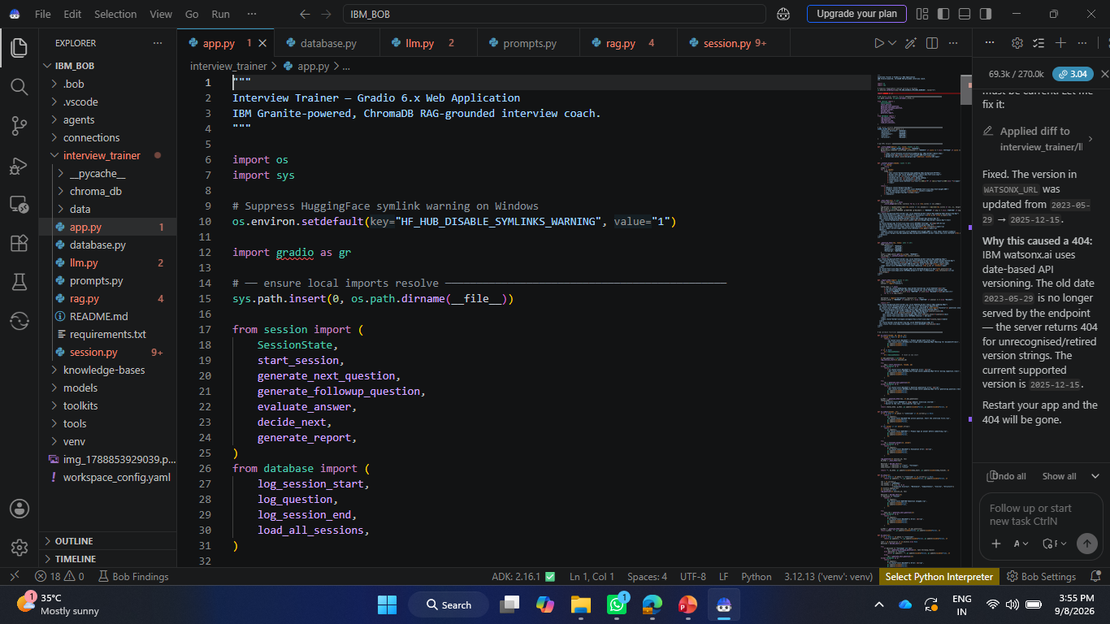
Required Files created using IBM bob -

Slide 8
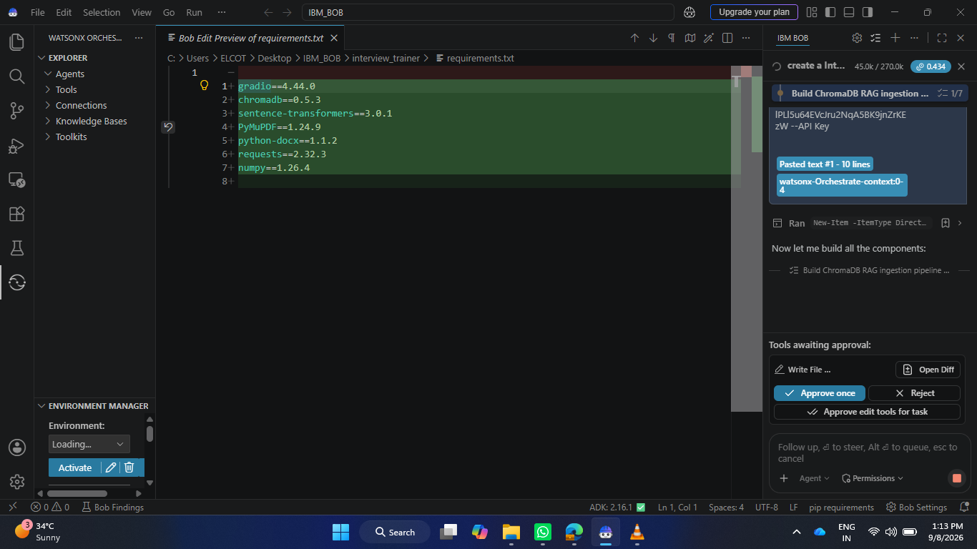
IBM Bob Screenshots:

Slide 9
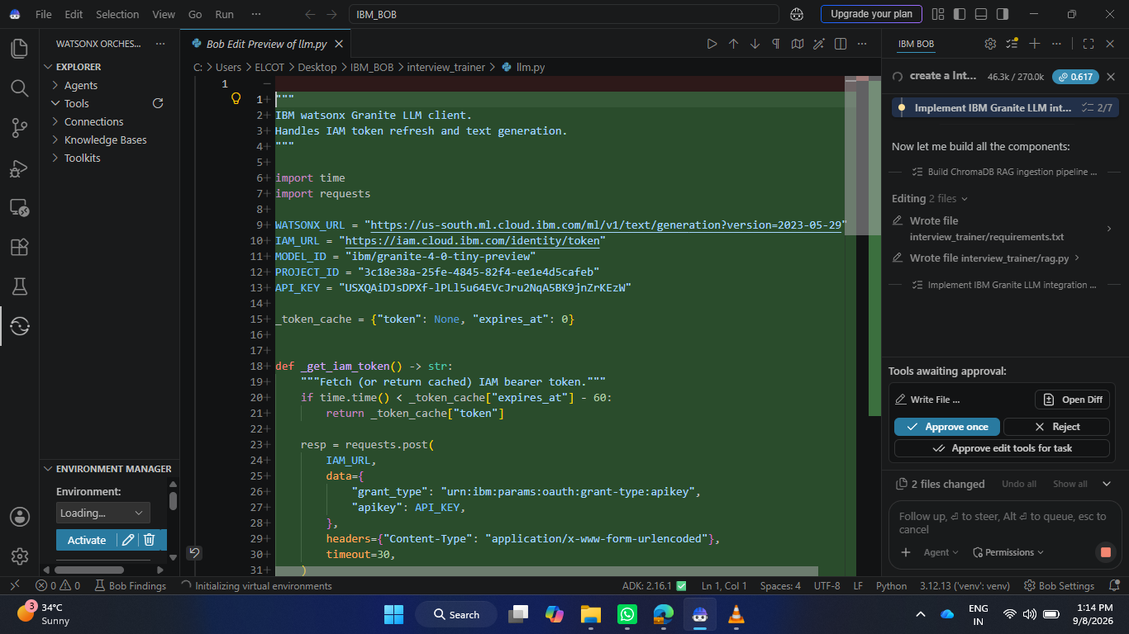

Slide 10
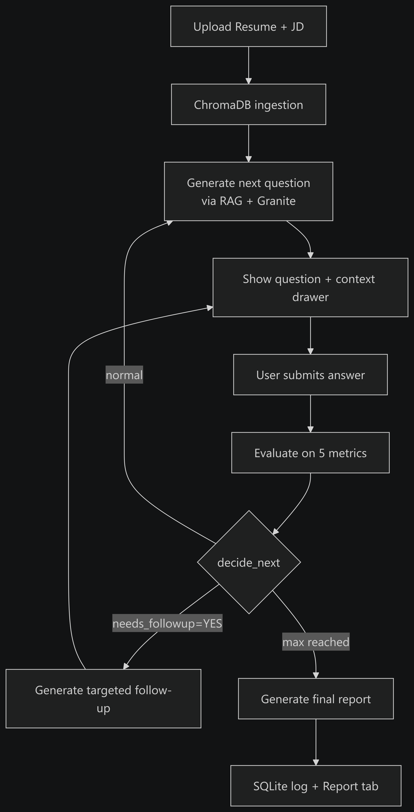
Architecture blueprint for IBM bob:

Slide 11

Role of Agentic AI in the solution
Role of Agentic AI in Interview Trainer Agent
Agentic AI transforms the Interview Trainer Agent from a passive, scripted chatbot into an intelligent, autonomous mock interviewer. Powered by IBM watsonx.ai and IBM Granite models, it drives the end-to-end interview workflow through context-aware decision-making:
Autonomous Multi-Agent Orchestration: Coordinates specialized sub-agents (Document Ingestion, Question Synthesis, Answer Evaluation, and Reporting) to manage the interview process from document parsing to final debrief without manual intervention.
RAG-Grounded Contextual Awareness: Ingests the candidate's resume and target job description via RAG, ensuring generated questions and evaluations are strictly anchored to verified user experience and role expectations.

Slide 12
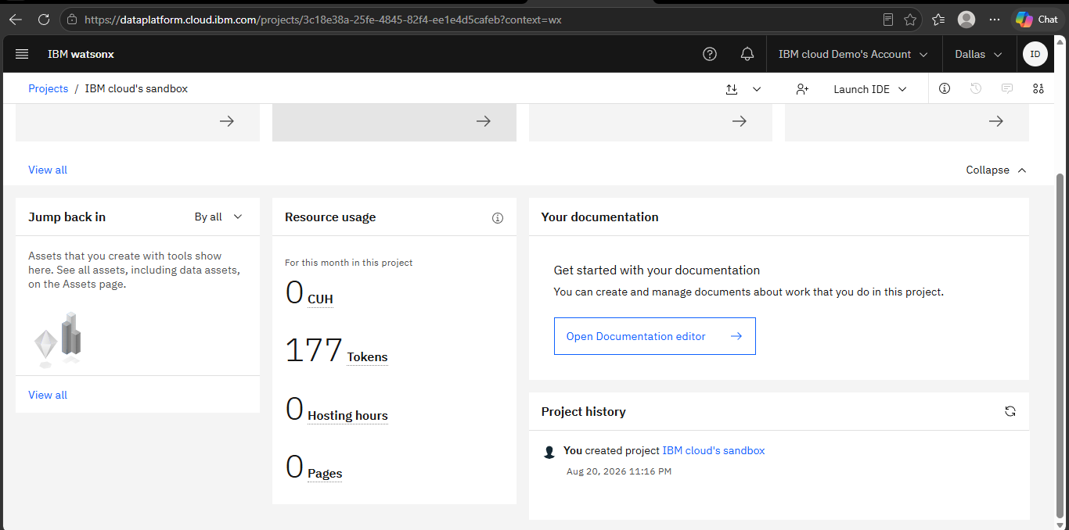
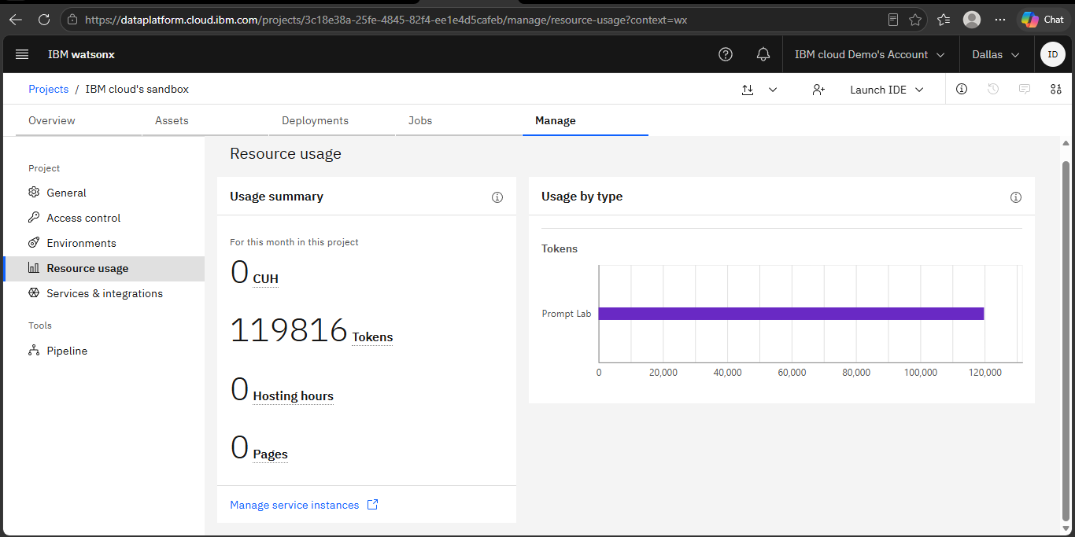
Token Usage
11,96,3961 token are used
Before Prompt
After the Prompt
·
·
·

Slide 13
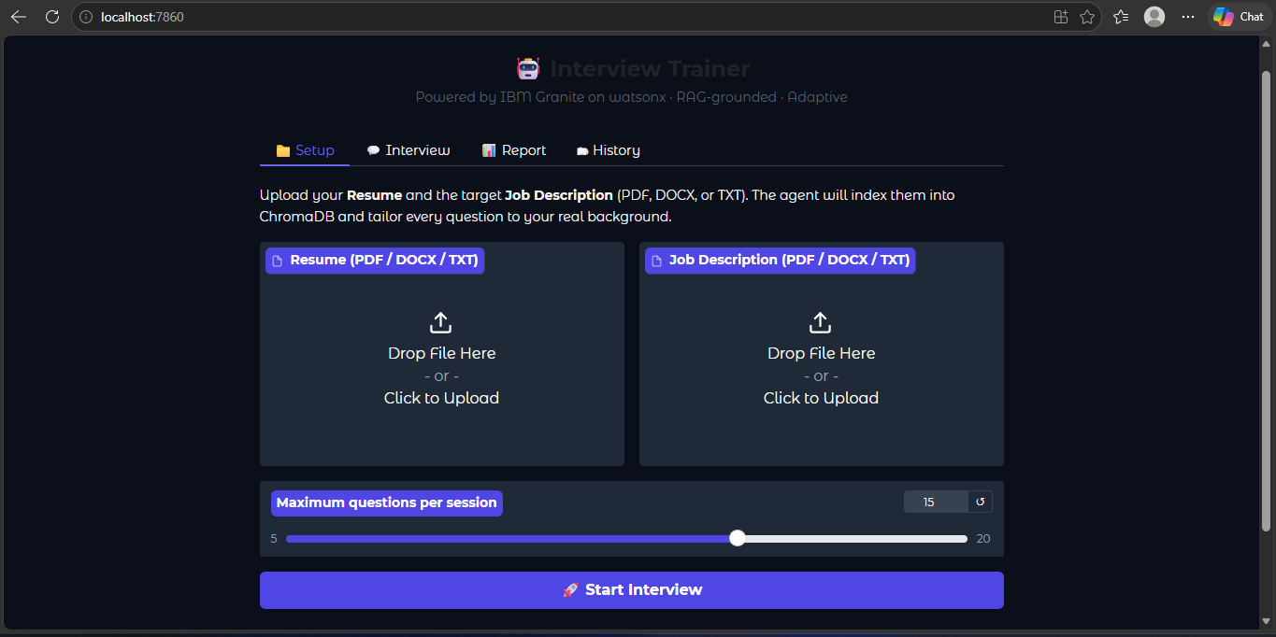
Project Output Screenshot
·
·
·

Slide 14
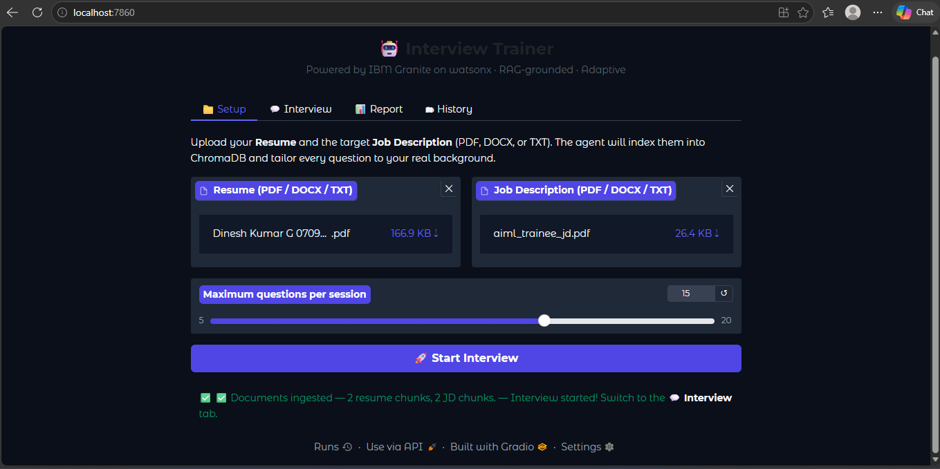
Project Output Screenshot
·
·
·

Slide 15
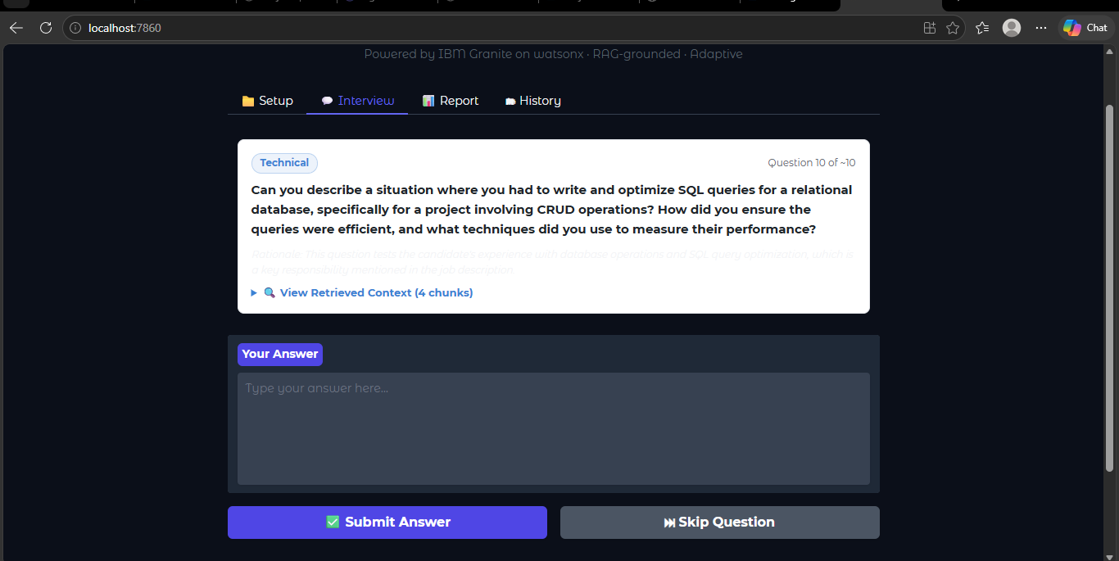
Project Output Screenshot
·
·
·

Slide 16
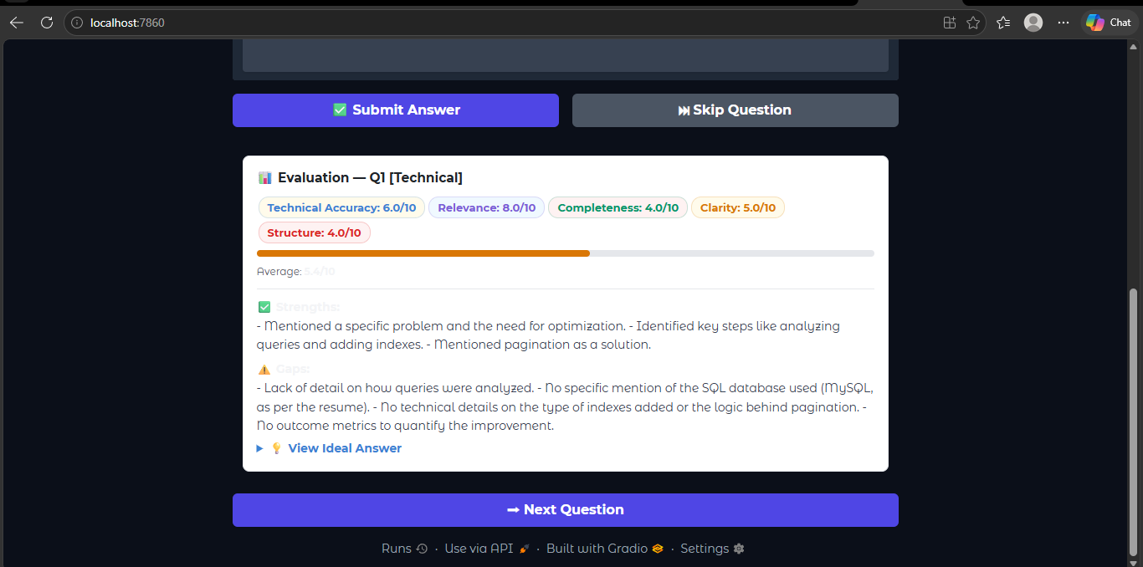
Project Output Screenshot
·
·
·

Slide 17
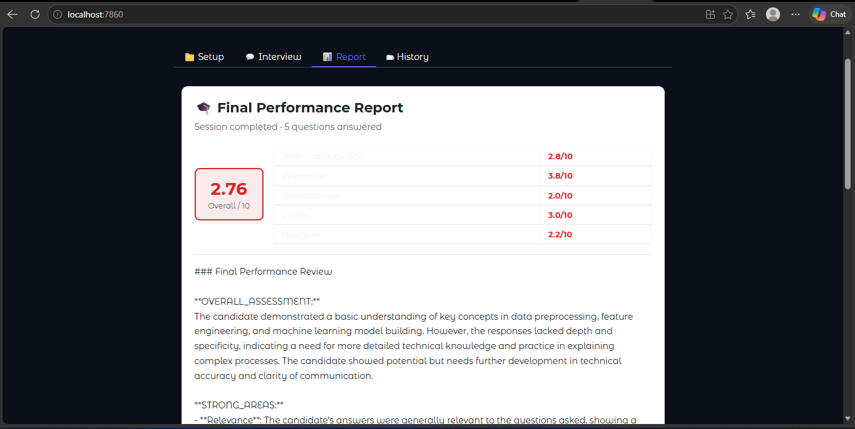
Project Output Screenshot
·
·
·

Slide 18
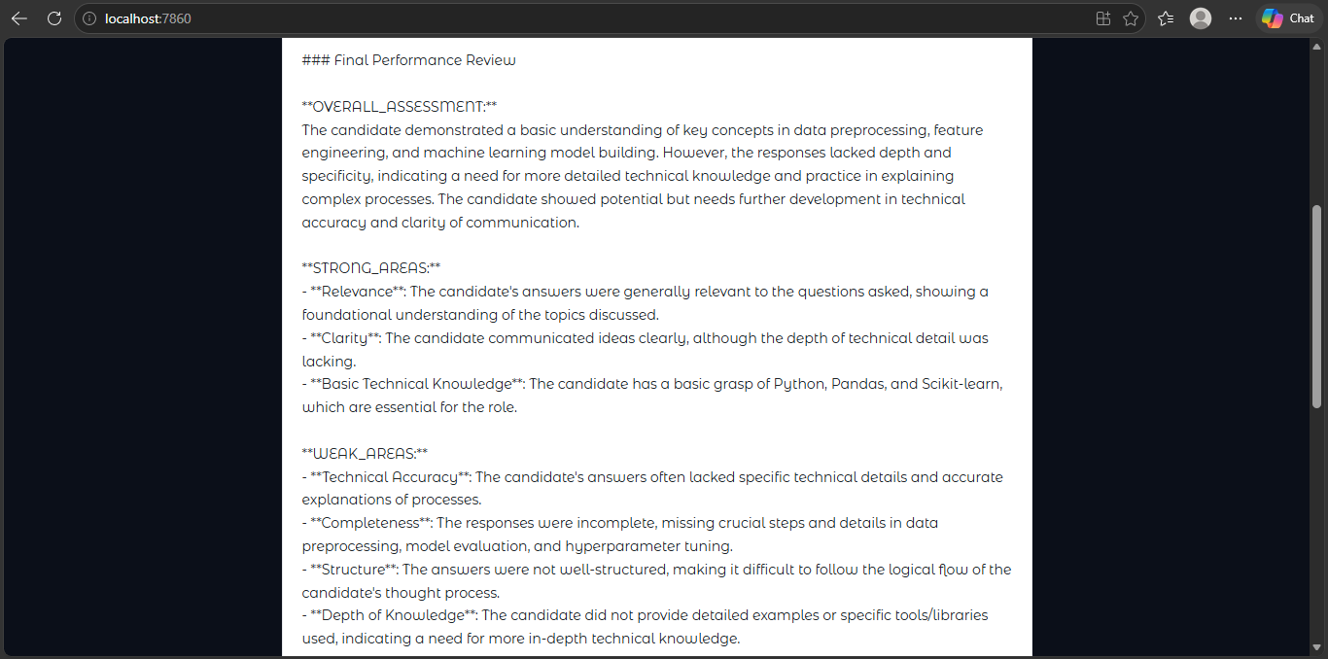
Project Output Screenshot
·
·
·

Slide 19
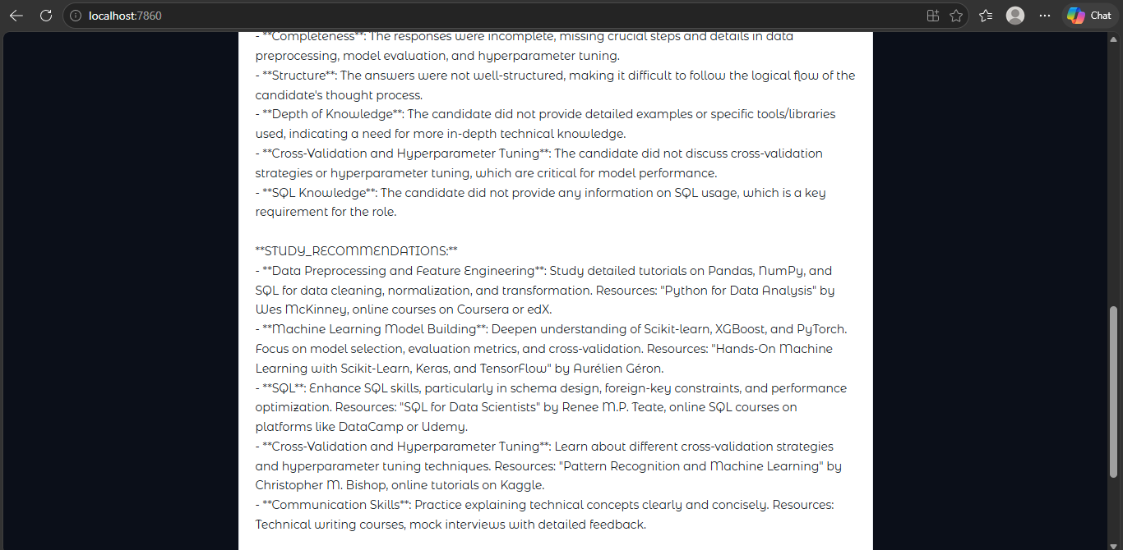
Project Output Screenshot
·
·
·

Slide 20
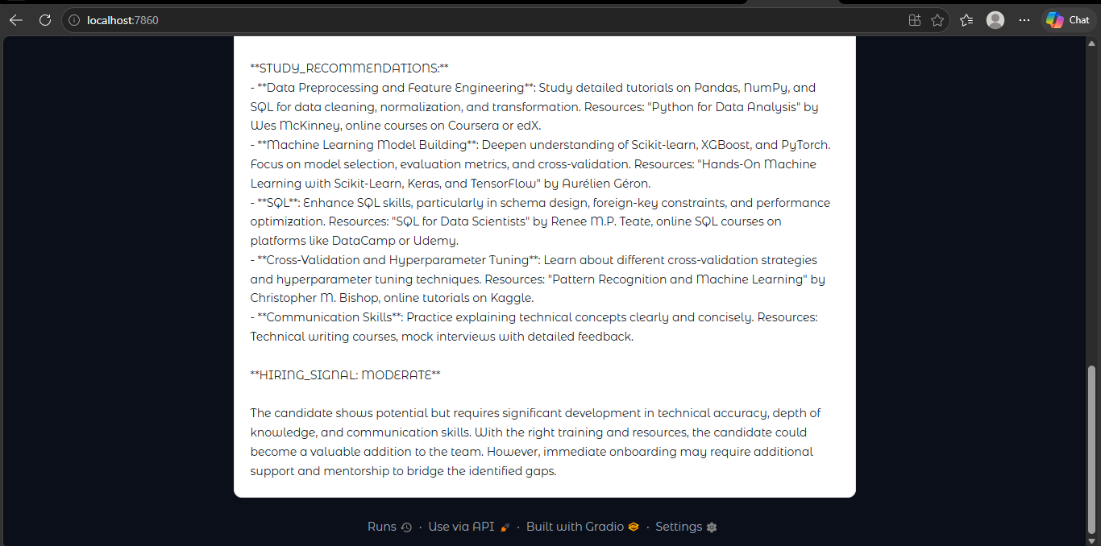
Project Output Screenshot
·
·
·

Slide 21
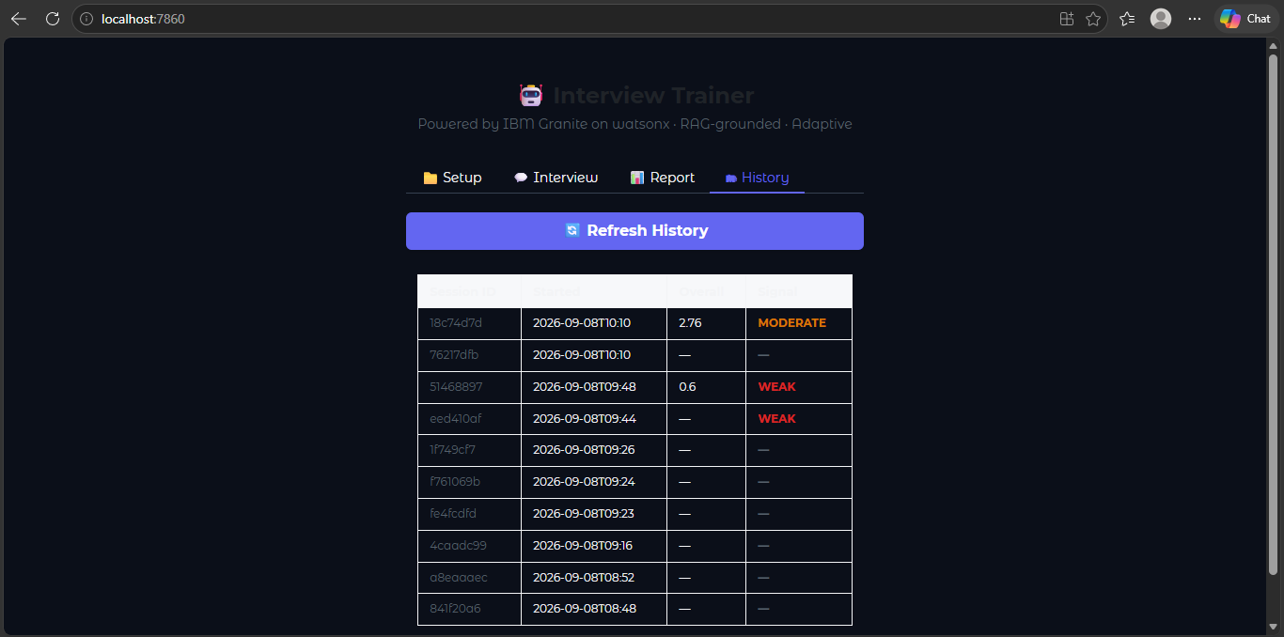
Project Output Screenshot
·
·
·

Slide 22
Novelty and Uniqueness
The proposed Interview Trainer Agent stands out by combining Agentic AI, RAG, and multi-metric evaluation into a single intelligent preparation system.
Multi-Agent Intelligence – Instead of a single static chatbot, multiple specialized agents collaborate (Document Ingestion, Interviewer, Evaluation, and Feedback Agents) to deliver context-aware interview guidance.
RAG-Based Accuracy – Integrates real-time document retrieval using ChromaDB with IBM Granite generation, ensuring questions and evaluations are grounded strictly in the candidate's uploaded resume and job description to eliminate hallucinations.
Hyper-Personalization – Tailors technical, behavioral, and project-based questions directly to the user's specific experience level, domain, and target job description.
Real-Time Feedback Loop & Adaptive Branching – Dynamically detects candidate weak spots and incomplete answers, immediately generating targeted follow-up questions to probe deeper before advancing.
Transparent RAG Inspection – Offers full explainability with a dedicated "View Retrieved Context" panel that displays the exact source document, document type, and chunk ID used for each question and evaluation.
This makes the solution a smart, adaptive, and proactive digital interview coach, not just a static question bank tool.

Slide 23
Git Hub Link
Github URL – Dinesh-kumar-07/Interview_Trainer_Agent: The Interview Trainer Agent is an AI-powered mock interview system built to help software developers prepare for technical and behavioral rounds.
·
·
·

Slide 24
Future Scope
Multimodal Voice & Video Evaluation:
Integrate real-time speech-to-text and audio processing to analyze speaking pace, tone, filler words, and vocal confidence during spoken responses.
Utilize computer vision models to evaluate candidate eye contact, posture, and facial expressions to deliver holistic behavioral interview feedback.
Embedded Interactive Coding Sandbox:
Incorporate an in-browser code editor with execution runtimes (supporting Python, Java, C++, SQL) to test algorithmic problem-solving in real time.
Direct IBM Granite to analyze code time/space complexity, style conventions, and edge-case handling against unit test suites
·
·
·

Slide 25
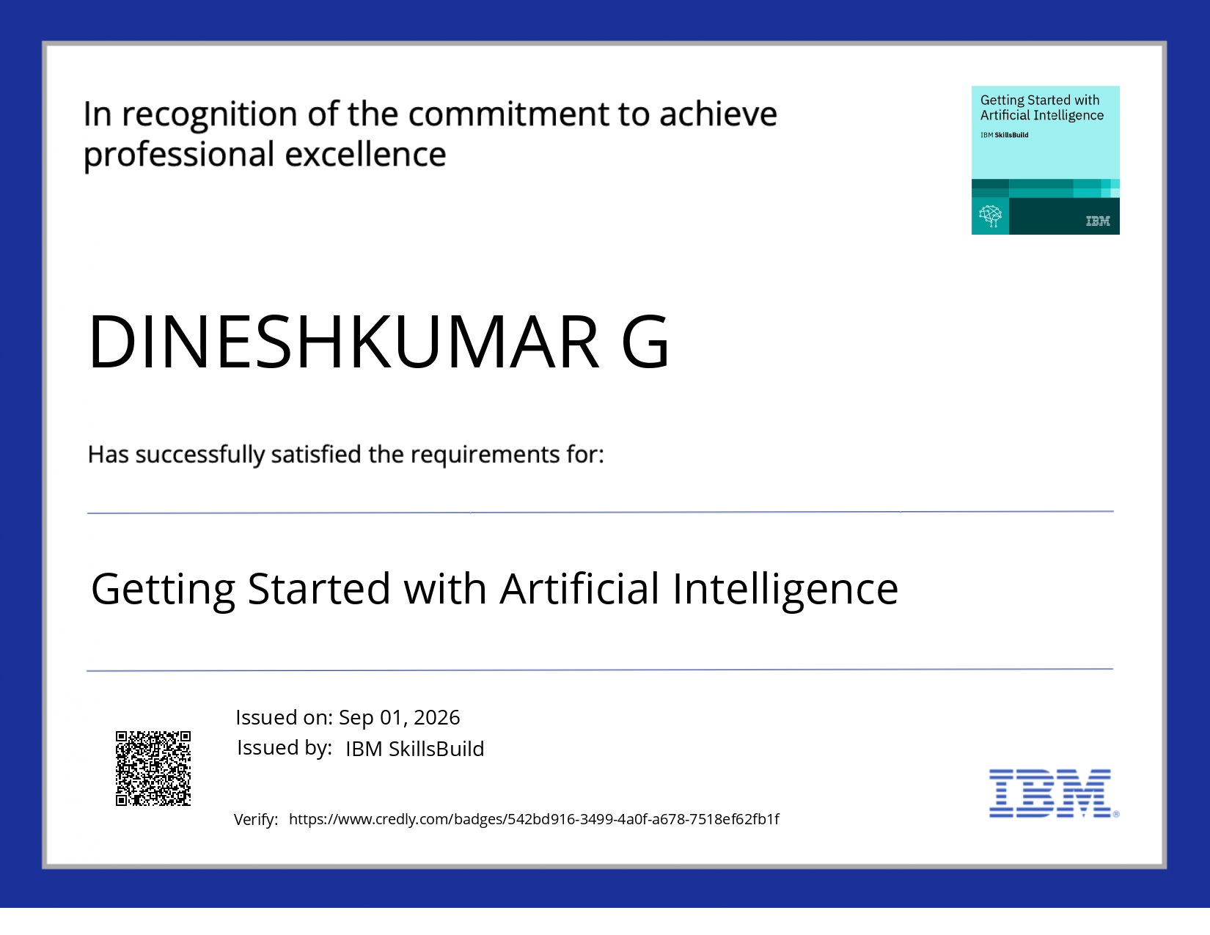
Certificates Earned:

Slide 26

Certificates Earned:​

Slide 27


